Slide 1
How to use BERT?
Department of Electrical Engineering
I-Shou University
The second year of the PhD degree
Chen Chien-Hua
2020/10/16

Slide 2
Transform words to numbers
Reclassification
Bag-of-Words
TF-IDF
Topic modeling:
Latent Semantic Analysis(LSA)
Latent Dirichlet Allocation(LDA)
Word embedding (Word2vec)
Paragraph vector (Doc2Vec)

Slide 3
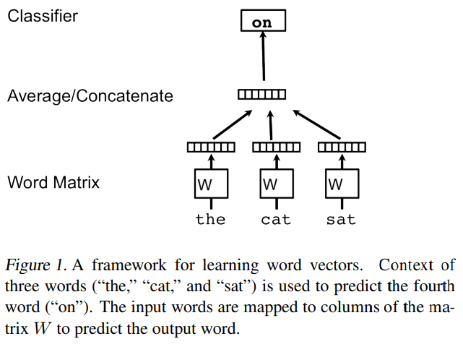
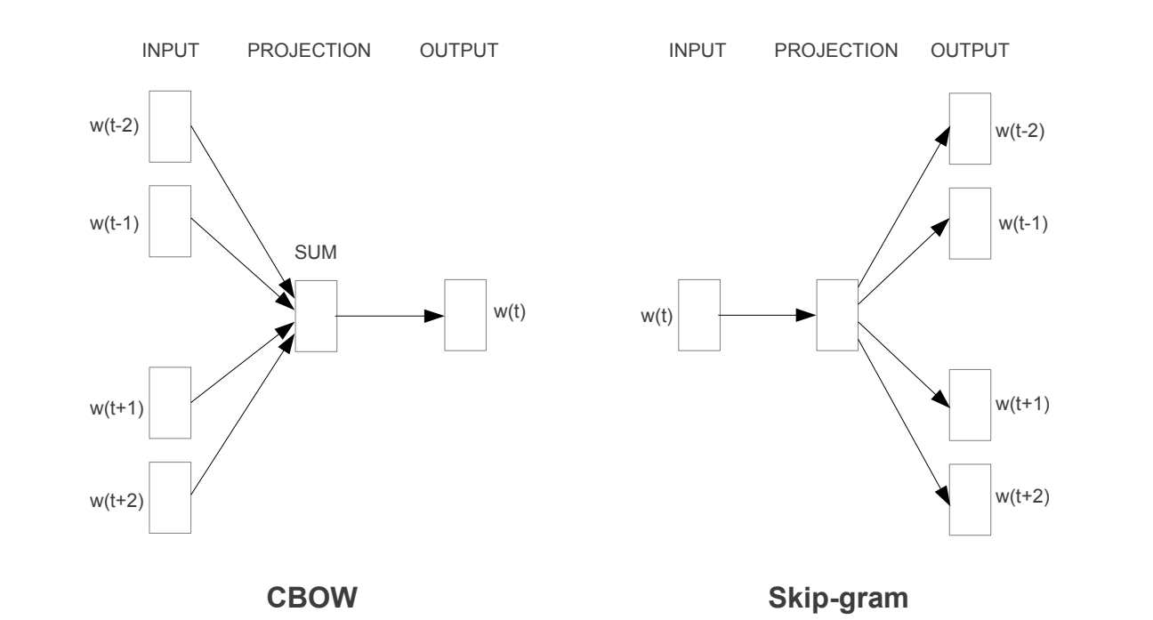
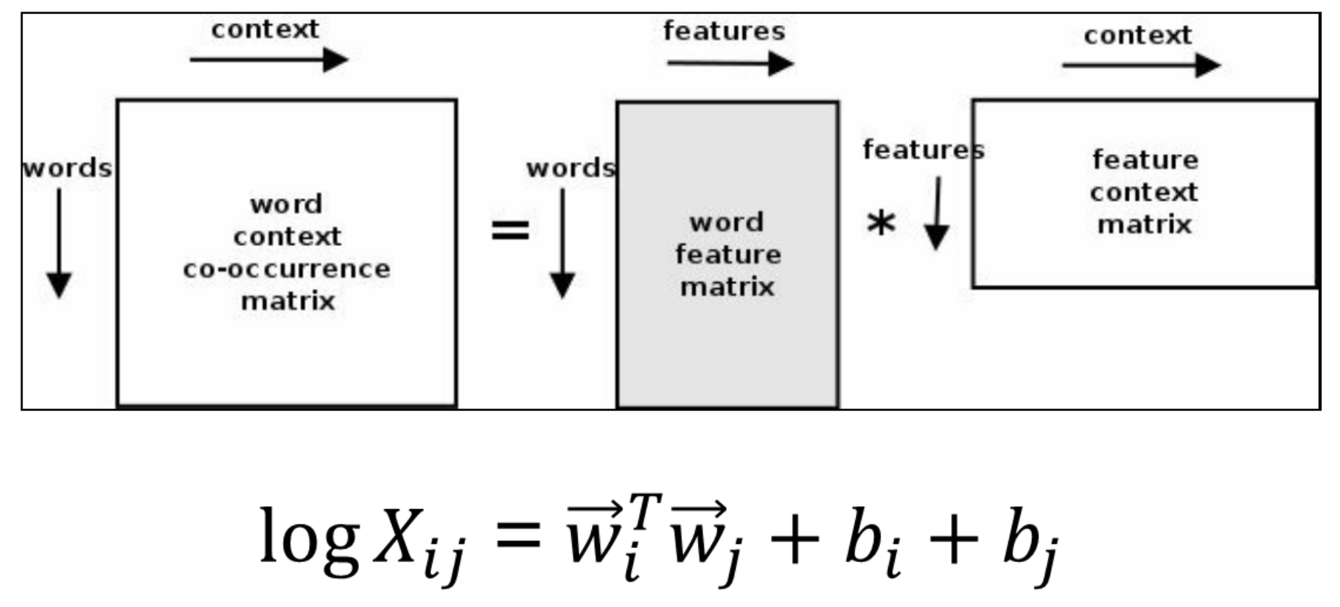
Word embedding
gensim.models.word2vec
Word2vec
Skip-gram
CBOW
FastText
GloVe
WordRank
GloVe

Slide 4
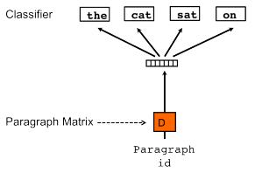
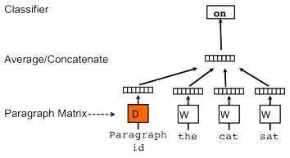
Paragraph vector
gensim.models.doc2vec
Distributed Memory
Distributed Bag of Words
Distributed Representations of Sentences and Documents
https://arxiv.org/abs/1405.4053

Slide 5
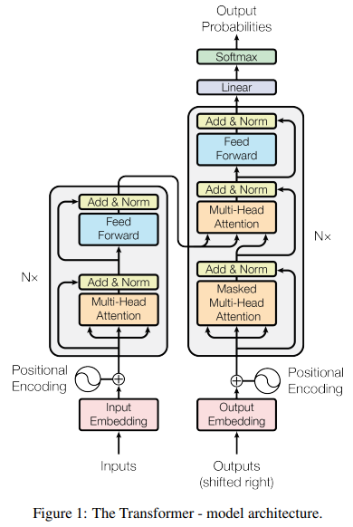
Transformer
Attention Is All You Need
https://arxiv.org/abs/1706.03762

Slide 6
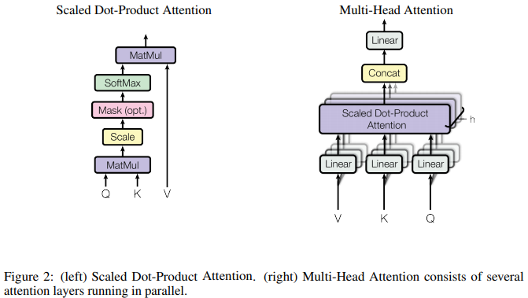
Attention
Attention Is All You Need
https://arxiv.org/abs/1706.03762

Slide 7
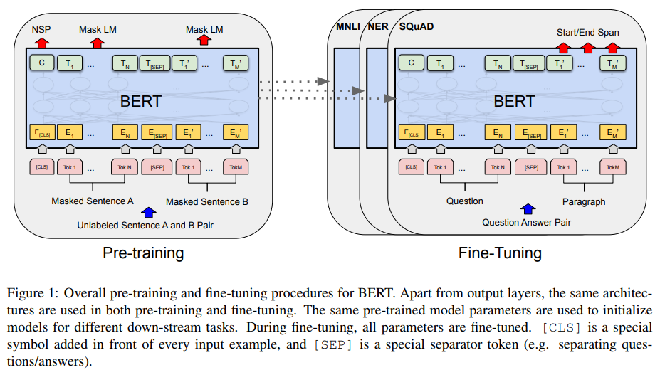
BERT Bidirectional Encoder Representations from Transformers
Google AI Language
BERT: Pre-training of Deep Bidirectional Transformers for Language Understanding
https://arxiv.org/abs/1810.04805

Slide 8
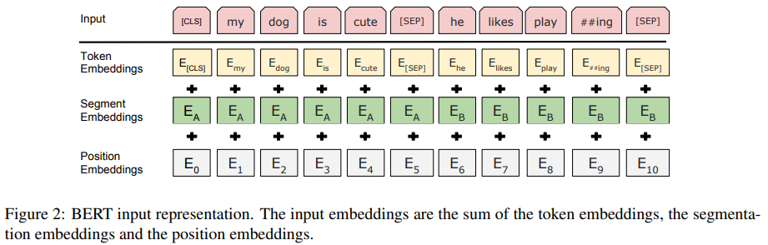
BERT input representation
BERT: Pre-training of Deep Bidirectional Transformers for Language Understanding
https://arxiv.org/abs/1810.04805

Slide 9
Pre-training BERT
Task #1: Masked LM (language model)
Task #2: Next Sentence Prediction (NSP)
Pre-training data
BooksCorpus (800M words) (Zhu et al., 2015)
English Wikipedia (2,500M words)
Two model sizes:
BERTBASE (L=12, H=768, A=12, Total Parameters=110M)
BERTLARGE (L=24, H=1024, A=16, Total Parameters=340M)
BERT: Pre-training of Deep Bidirectional Transformers for Language Understanding
https://arxiv.org/abs/1810.04805

Slide 10
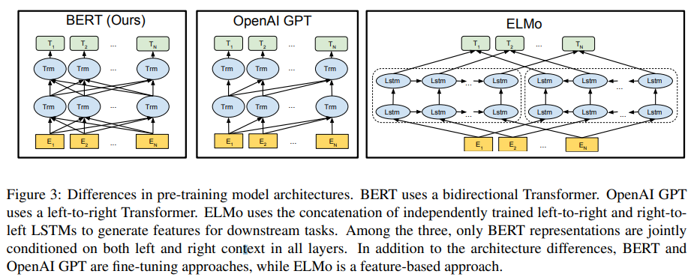
Differences in pre-training model architectures
BERT: Pre-training of Deep Bidirectional Transformers for Language Understanding
https://arxiv.org/abs/1810.04805

Slide 11
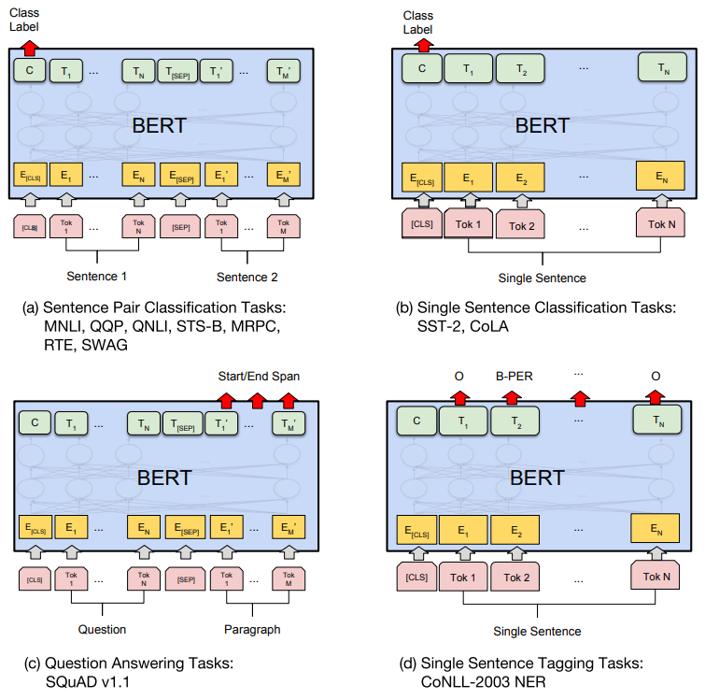
Fine-tuning BERT on Different Tasks
BERT: Pre-training of Deep Bidirectional Transformers for Language Understanding
https://arxiv.org/abs/1810.04805

Slide 12
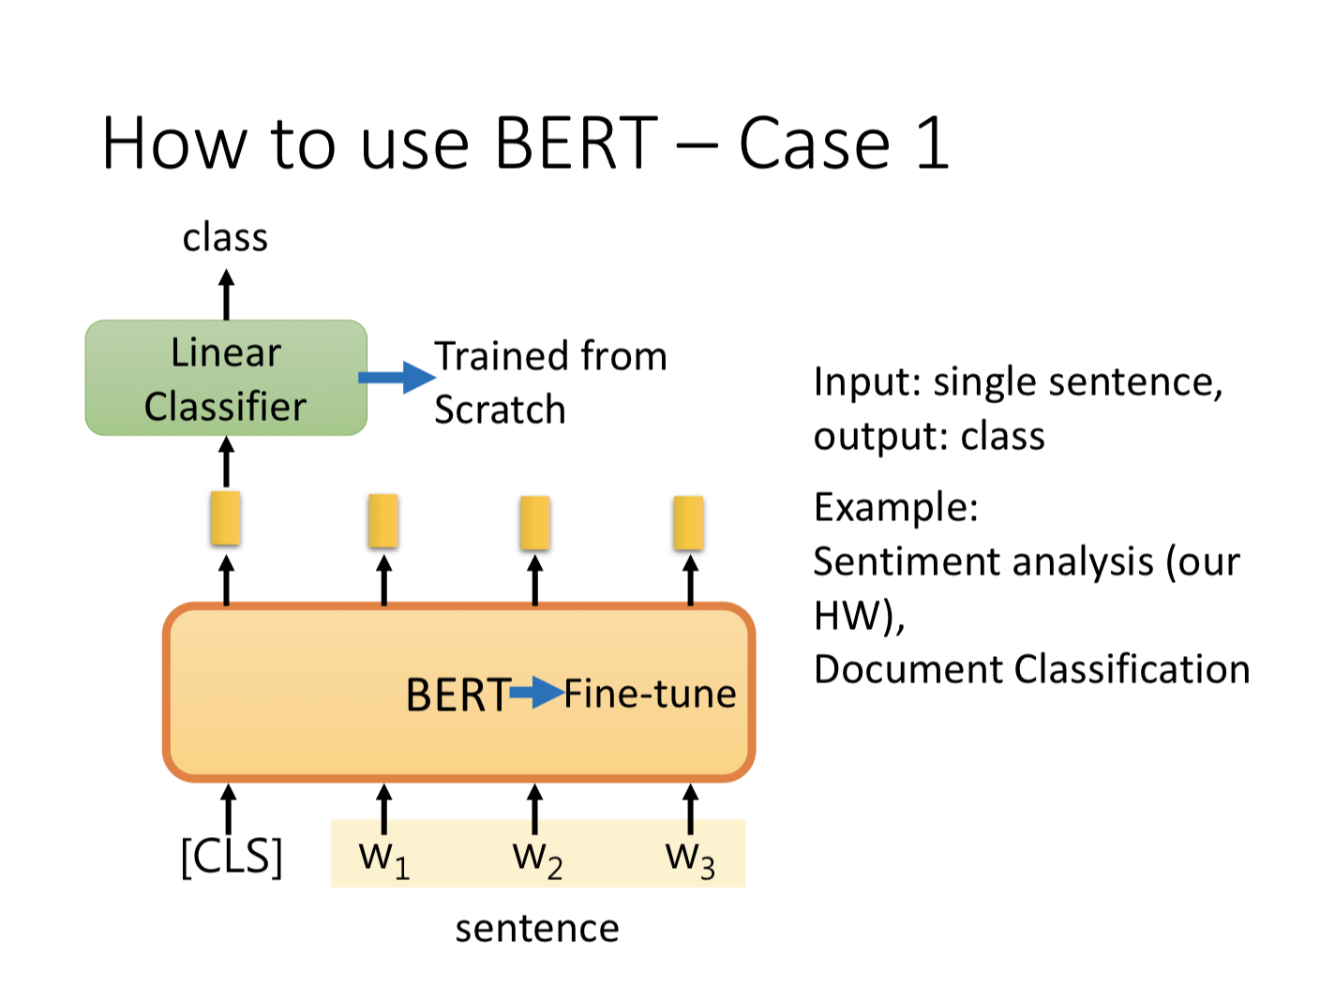
https://www.youtube.com/watch?v=UYPa347-DdE

Slide 13
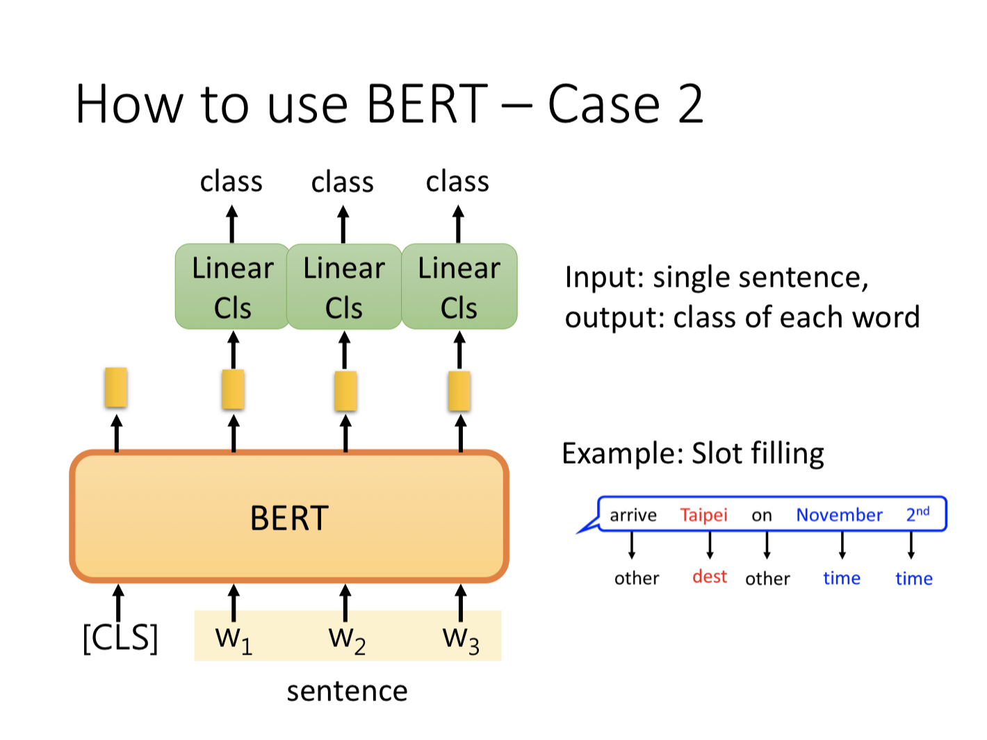
https://www.youtube.com/watch?v=UYPa347-DdE

Slide 14
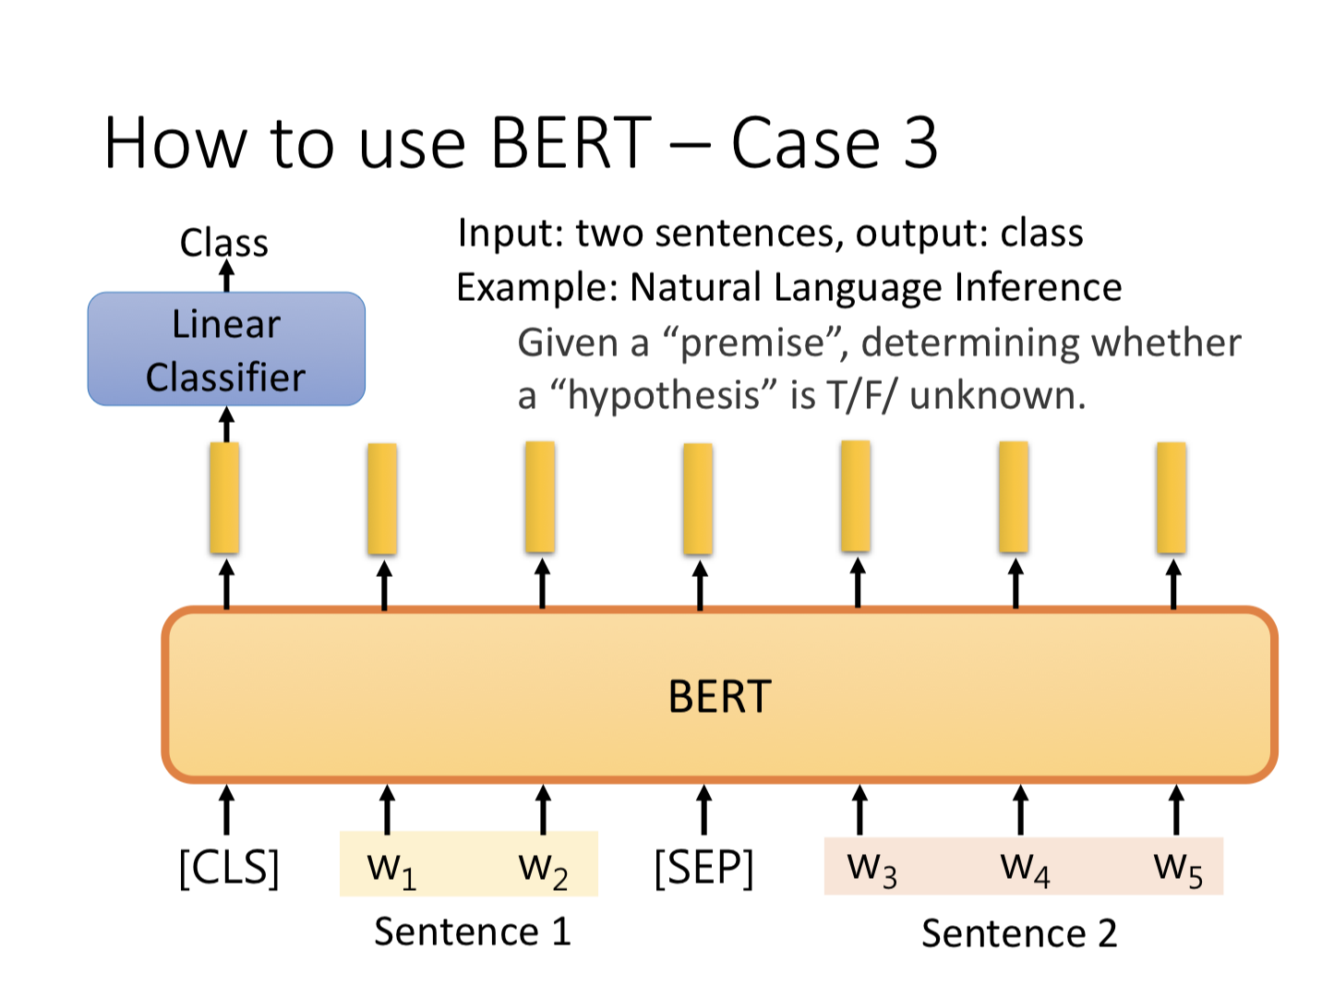
https://www.youtube.com/watch?v=UYPa347-DdE

Slide 15
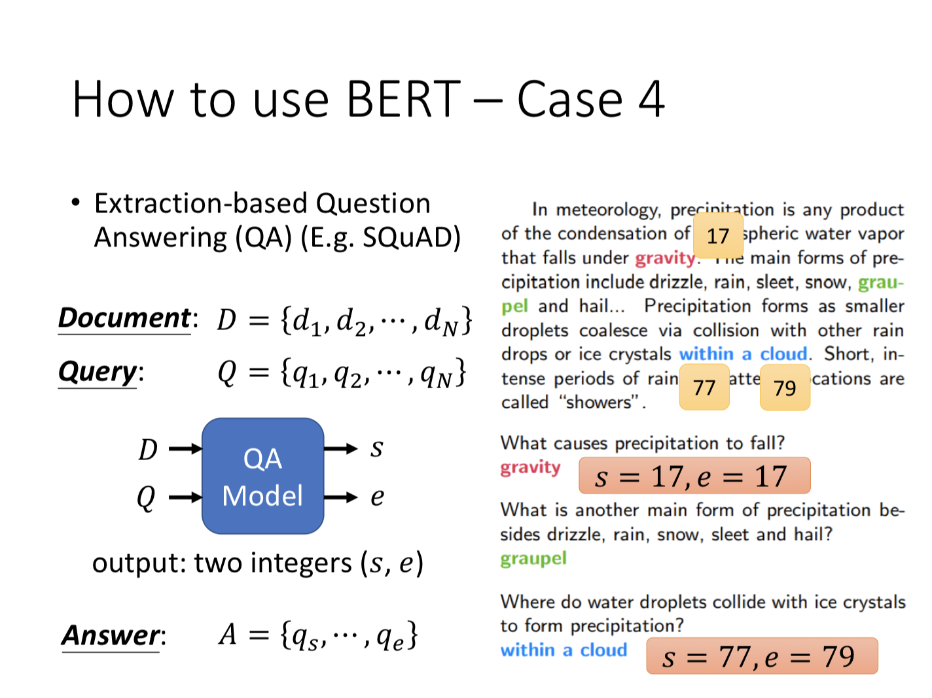
https://www.youtube.com/watch?v=UYPa347-DdE

Slide 16
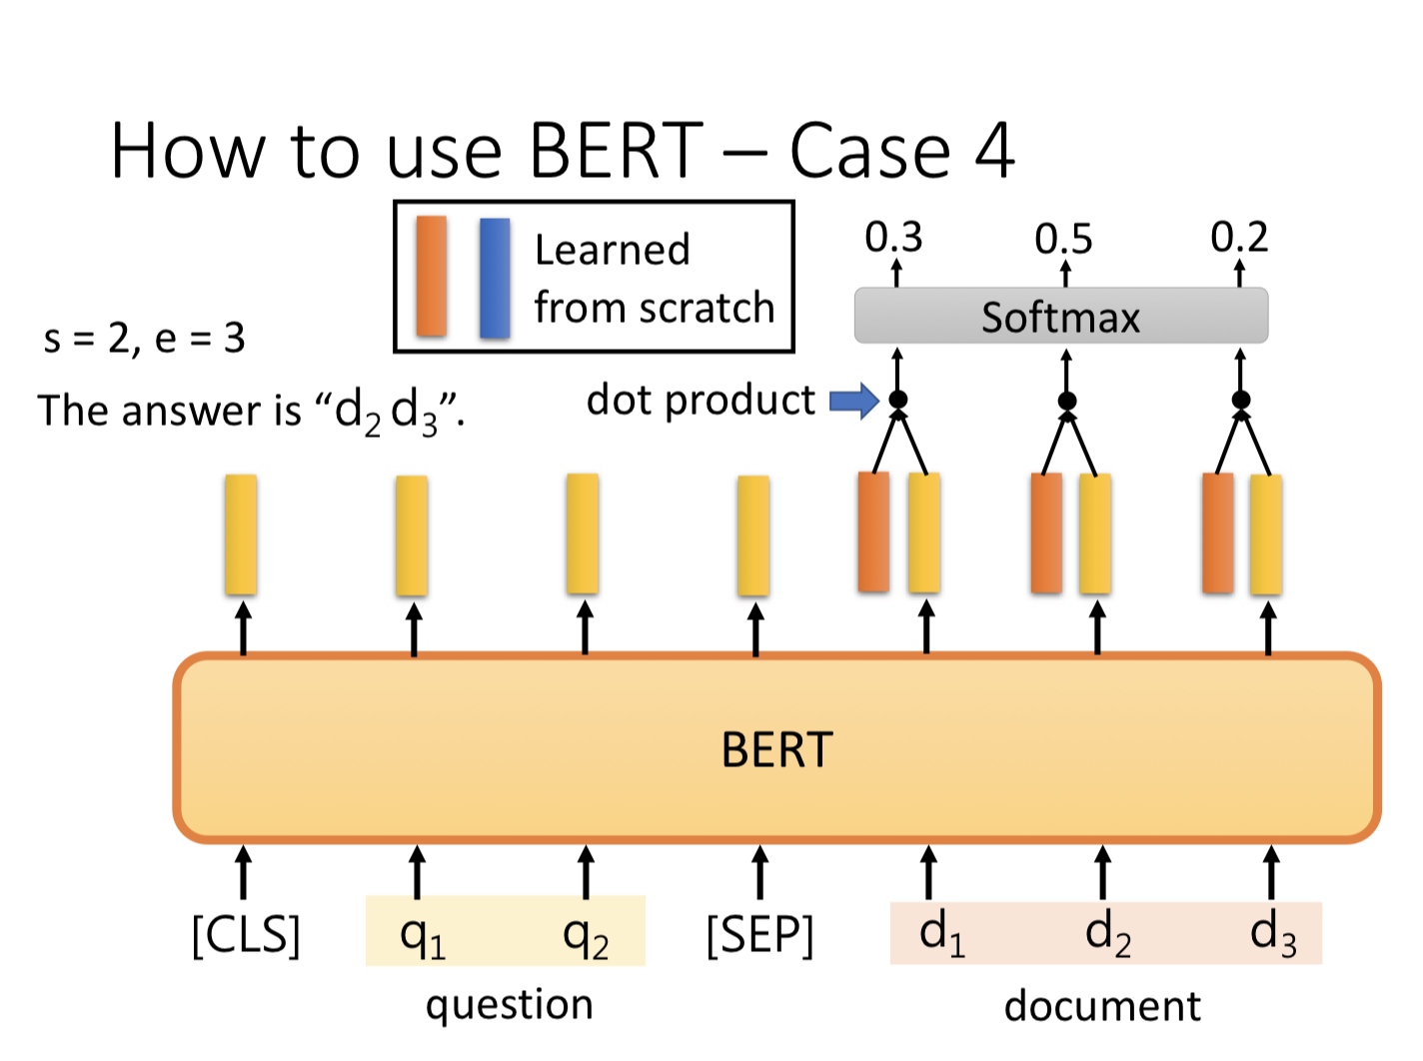
https://www.youtube.com/watch?v=UYPa347-DdE

Slide 17

How to use BERT?
https://github.com/chienhuachen/BERT

